Slide 1
Hybrid Pruning of GPT-2
Combining L1-Based FFN Pruning and Attention Head Pruning
By Deekshith B | USN: 1BM22CS082

Slide 2
GPT-2
Transformer-based decoder-only model
GPT-2 is trained to predict the next token given all previous
GPT-2 small has 12 decoder blocks
Each block contains 12 attention heads
Total parameters: ~124 million

Slide 3
Pruning
Pruning removes unimportant weights, neurons, or structures from neural networks
Why Prune:
- Reduce model size - Save memory and power
- Speed up inference - Improve generalization
What to Prune:
- Individual weights - Entire layers
- Attention heads - Neurons / filters / channels

Slide 4
Why Hybrid Pruning?
Unstructured pruning
- Removes small-magnitude weights (e.g., in FFN layers)
- Causes sparsity — good for compression but irregular shape
Structured pruning
- Removes whole neurons, filters, or attention heads
- Keeps model clean and fast, but needs careful selection
Hybrid
- Combine both methods for optimal compression-performance ………trade-off

Slide 5
Attention Head Pruning
Each transformer block in GPT-2 has 12 self-attention heads
Each head captures different linguistic or positional relationships
Some heads contribute less to model performance
Structured pruning removes low-impact heads
Attention(Q, K, V) = softmax(Q × Kᵀ / √dₖ) × V
Reduces computation and improves inference time
Must be applied layer-wise and cautiously

Slide 6
Feedforward Network (FFN) Pruning
Each decoder block contains a 2-layer FFN:
Linear → GELU → Linear
FFNs contain over 60% of the model’s total parameters
We apply L1-based unstructured pruning to set small weights to zero
This does not remove neurons directly but creates sparsity in weights
Results in high compression while preserving layer shape and output fluency

Slide 7
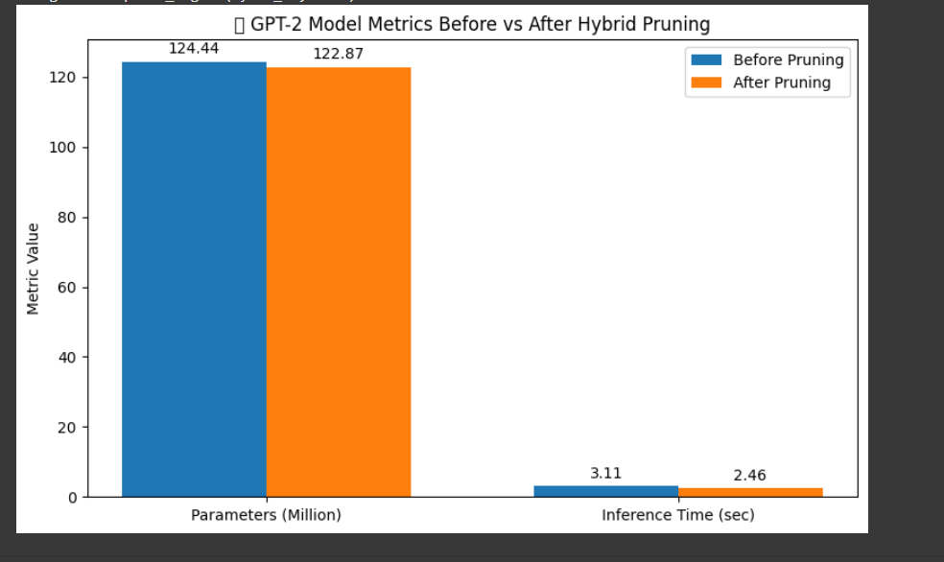
Conclusion & Visuals
• Hybrid pruning leverages the strengths of both unstructured and structured techniques

